Slide 1
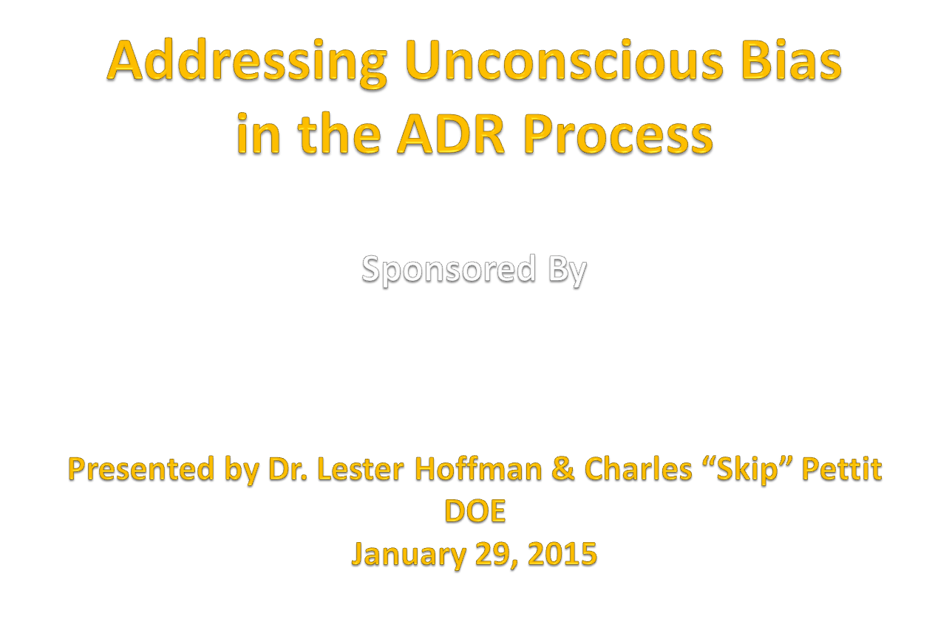

Slide 2
About Your Instructors
Dr. Lester Hoffman & Charles “Skip” Pettit are the authors of the book, “Moving Beyond Bias: Bias-Free Communication Strategies for Today’s Organization.” Each is a renowned workshop leader, keynote speaker, and consultant in Diversity & Inclusion, Unconscious Bias, & Leadership. Their clients include 30+ federal agencies (DOE, FEMA, VA, NOAA, US Navy, FCC, Pentagon, NIH, Census Bureau, NIH, etc.), as well as numerous Fortune 250 organizations, including IBM, AT&T, Pfizer, FedEx, Prudential, Lockheed-Martin, Xerox, Bank of America, Merck, JP Morgan/Chase, Citigroup, Alcoa, & Mitsubishi.

Slide 3
Agenda & Goals For The Session
Explore impact of Unconscious Bias on Mediation/ADR
Define Unconscious Bias
Anti-bias tools, techniques, & principles

Slide 4
Guiding Principles
Everyone IS Biased
Bias is normal – so is being unaware of it
Unchecked bias __________
Unconscious bias impacts __________
  NOTE: ALL professionals must be aware of potential bias, and ADR practitioners especially must be hyper-vigilant about bias in the ADR process!

Slide 5
Characteristics: ADR Practitioners Must Be
  P
  F / O
  I / N
  F
  H____________________/Free of conflict of interest
  A
  C

Slide 6
Inclusive Behaviors For the ADR Practitioner
Work for the common good!
L
C
S
Build
A
Experience
Leverage
Move from

Slide 7
ADR Processes & Bias
Common types of ADR for civil cases are, __________, ________________, __________________, ___________, ____________,_______________, _________________, ___________, _______________________ & ___________.
UNCONSCIOUS BIAS impacts them all!

Slide 8
Impact of Unconscious Bias
  D & J
  P & B
  B & C
  E /A /E
  __________ when “stories differ”
  Whether we think __________________

Slide 9
How Unconscious Bias
Can Undermine the ADR Process
  L___________ & A_______________
  Omissions/Perceptions→ _________/________
  I________ D_____________
  S___________ T___________
  L__________/Accents/N______/Stereotyping
  Real/perceived ____________ between parties
  Real/perceived ____________ between _______ & ______

Slide 10
Exercise—
Personal or Organizational “Blind Spots”
What are YOUR blind spots?
  ...
  …
  …
  …

Slide 11
Taking The Blind Spot Challenge

Slide 12
Definitions Impacting Unconscious Bias
Micro-Inequities (Mary Rowe, MIT, originator):
1. Undercover, hard-to-prove, hurtful covert events/ communications/omissions, often unintentional, & unrecognized by perpetrators, “felt” by recipients …
OR Micro-Inequities: Ways that individuals are singled out/overlooked/ignored or discounted, based on unchangeable characteristics, such as race/gender/age
Subtle/Unconscious Bias: Non-litigable actions or omissions involving micro-inequities/micro-aggressions
Micro-Aggressions: Micro-inequities with a hostile, derogatory, demeaning, or other strong negative quality

Slide 13
Inclusionary/Exclusionary Factors
A
A
C
H
Age/Generation/Gender
Introversion/Extroversion
W
R
Sexual Orientation (real/perceived)

Slide 14
Inclusionary/Exclusionary Factors
Background (where you’re from, education, military experience, etc.)
Parental status
F
Appearance
E
H
T

Slide 15
Unconscious Bias: Factors To Consider
Traditional/Non-Traditional Thinker
_____
_____
_____
_____
______
____
_____
____ /
_____ Abilities
______
_____
______
______
_____
_____
____
______
_____
_____
______
___
_____

Slide 16
Biased Language & Actions
Biased phraseology
“Female SES”
How you say something
Positive stereotyping
Note: Adapted from “Moving Beyond Bias,”
© Copyright, 2002, Dr. Lester Hoffman

Slide 17
Reactions to Accents (Univ. of Chicago Study)
  “Accent discrimination” – usually unconscious
  Independent of ____________________
  Accents perceived as ____________________
  Difficult to understand ……. (brain processing)
  Bias against foreign speech
An excellent example of DKDK!

Slide 18
Examples of Name Bias
“Are Emily & Greg More Employable Than Lakisha & Jamal?”
Published in Bureau Economic Research journal, 2002
Identical resumes submitted to 1300+ employers
More call-backs for ______________
______________
______________
Note: Adapted from “Anti-Bias Strategies,” © Copyright, 2012, Dr. Lester Hoffman

Slide 19
Examples of Unconscious Bias: Omissions
“Inadvertently” ______________________________________________________________________________________
Invisibility – e.g., ______________________________________________________________________________________
Excluded ______________________________________________________________________________________
Feigning inclusion ______________________________________________________________________________________

Slide 20
Questions To Consider: Individual Action Plan
1. What specific actions can I take?
2. What needs to be done in my organization?
3. How can I help others understand?

Slide 21
Sources of Biased Perceptions/Judgments/Behaviors
That Mediators/Arbitrators Must Be Aware Of
Stereotype
Definition: oversimplified, inaccurate, generalized, and fixed or rigid image of a person or persons belonging to a particular group
…
…
…
…
  …
  …

Slide 22
Sources of Biased Perceptions/Judgments/Behaviors
Mediator perceptions
The Parties
Contrasts/differences _________________________________
Contrasts/differences BETWEEN _______________________
Similarity → ______________________________________________________________________________________________________________
  _______________________ Identity conflicts/identity sharing
Recency / Primacy
Halo / Horns

Slide 23
Bias In Language
Power of Language
Mediator Language
…
Differences
Internal dialogue
…

Slide 24
Examples of Biased Perceptions/Judgments/Behaviors
Use of language – Gender & Age Differences
“Bro”
“Listen, honey”
“Thug”
“Hey, Junior”
“Grandpa”

Slide 25
Power Imbalances
Examples:
  Supervisor -- Employee
  CO / KO / COR -- Vendor / Contractor
  Landlord -- Tenant
Imbalances
Actual versus perceived

Slide 26
Personal Strategies: “What Can You Do?”
Commit to self-awareness
Assess your bias at: www.implict.harvard.edu
Be open to acknowledge your bias
Discomfort … why?
Notice stereotypes
Greet people authentically—say Hello
Explain the Mediation/ADR Process

Slide 27
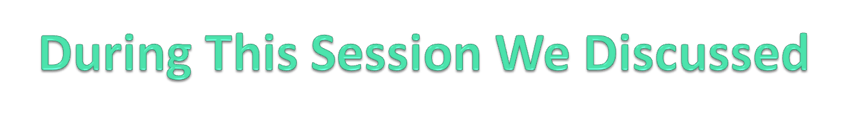
1. Guiding principles – be aware of potential bias
2. Inclusive behaviors – Characteristics of Mediators/ADR
3. Impact of Unconscious Bias
4. DKDK Blind Spots & Micro-Inequities
5. Inclusionary/Exclusionary Factors & Stereotypes
6. Mediator perceptions/language/actions
7. Power Imbalance (actual or perceived)
8. Create Individual & Organizational Action Plans to confront Unconscious Bias

